Slide 1

Smoking Does Not Belong in the Workplace
Anthony Meunier
DeVry University

Slide 2
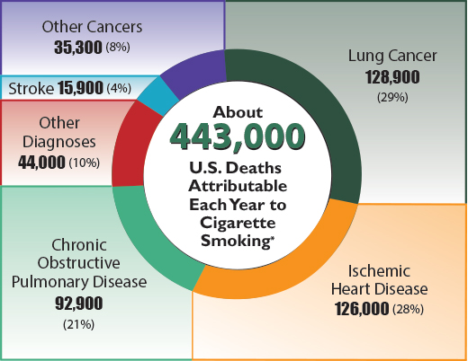
Tobacco use leads to disease, disability, and death.
18% of U.S. adults smoke
443,000 deaths per year
Single most preventable cause of both morbidity and premature death
For every death, there are about 20 more that suffer from at least one serious smoking-related illness

Slide 3
Smoking not only affects yourself, but the community and environment as well.
1.69 billion pounds of cigarette butts as waste each year
18.6 billion trees consumed in producing cigarettes
Your tax dollars are being used to clean up smokers’ trash
Secondhand smoke causes heart disease, lung cancer, asthma, and respiratory infections
No smoking laws exist in many public places, so why not at work?

Slide 4
Increased absenteeism and decreased productivity in the workplace.
Smokers miss 6.2 days of work per year compared to 3.9 for non-smokers
Smoke breaks average 15-30 minutes of lost productivity each day
Not only affects the company, but impacts economy all around
Significant decline in absenteeism shown in former smokers

Slide 5
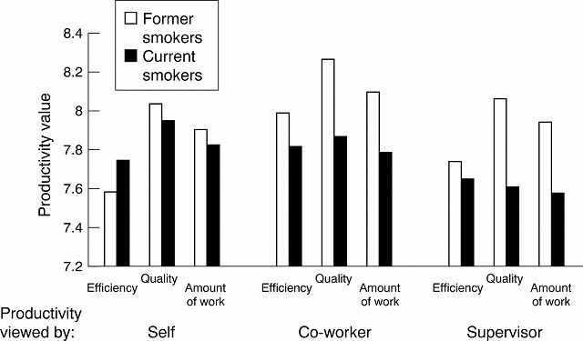
Productivity of smokers is significantly less than non-smokers.

Slide 6
The financial implications of employee smoking are extensive.
Less dollar amounts in revenue generated by smokers vs. non-smokers
Increased health care costs paid by employer:
Smoking illnesses cost employers $2,300 per smoker in lost productivity each year
Another $2200 in worker’s compensation compared to just $175 for non-smokers

Slide 7
How can we minimize negative effects and make positive changes?
Steps to a smoke-free workplace:
Implement no smoking policy
Detail benefits of a tobacco-free workplace
Provide quit smoking programs
Encourage change in behavior

Slide 8

It is in the best interest of the company to prohibit smoking.

Slide 9
References
American Cancer Society. (2013). Tobacco use in the workplace: a model policy. Retrieved from http://www.cancer.org/healthy/stayawayfromtobacco/smoke-freecommunities/createasmoke-freeworkplace/smoking-in-the-workplace-a-model-policy
Fox, M. (2013). Smoking employees cost $6,000 a year more, study finds. Retrieved from http://www.nbcnews.com/health/health-news/smoking-employees-cost-6-000-year-more-study-finds-f6C10182631
Halpern, M., Shikiar, R., Rentz, A. M., & Khan, Z. M. (2001). Impact of smoking status on workplace absenteeism and productivity. Retrieved from http://tobaccocontrol.bmj.com/content/10/3/233.full
Mayo Clinic. (2012). Secondhand smoke: avoid dangers in the air. Retrieved from http://www.mayoclinic.org/healthy-living/adult-health/in-depth/secondhand-smoke/art-20043914
Patterson, S. (2012). Smokers miss more work, study shows. Retrieved from http://www.webpronews.com/smokers-miss-more-work-shows-study-2012-11

